Slide 1
Computer Networks
Course Code CPS-422
NW Media
Lab 01
Demonstrator Kabeer Ahmed
MS Telecommunication and Networks from Iqra University

Slide 2
Network?
A set of nodes/entities connected via some medium
A group of computers and devices interconnected by communications channels that facilitate communications among users and allows users to share resources

Slide 3
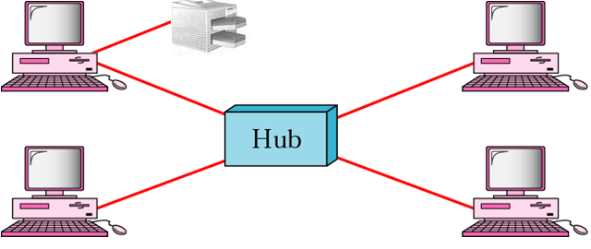
Why Networks?
Facilitating communications
Sharing hardware/Software
Sharing files, data, and information
Access to remote resources
Optimising resources - load balancing
Incremental growth of computer systems (reduced cost and risk)
Increased robustness through graceful degradation

Slide 4
Communication Networks?
Many forms of communication networks around
  Postal mail, telephone, Internet etc.
Generic steps involved in communication
  Addressing, name-to-address translation, transport, routing, delivery
Forms of delivery
  Reliable, in-order (TCP)
  Unreliable, no acknowledgement (UDP)

Slide 5
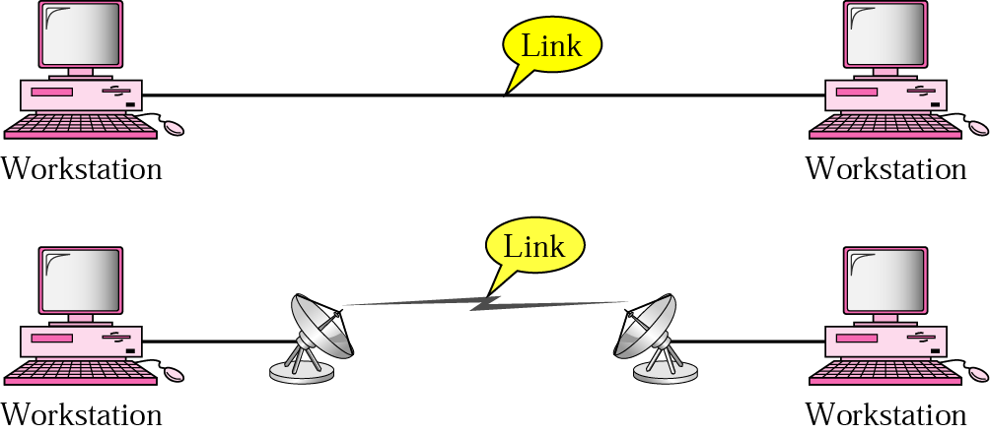
Point-to-point connection
A point-to-point connection is a direct link between two devices (guaranteed bandwidth)

Slide 6
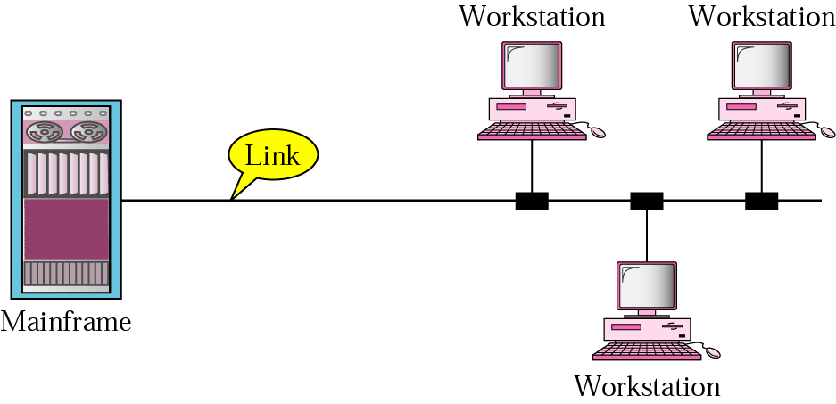
Multipoint connection
A multipoint connection is a link between three or more devices. Overall bandwidth is divided among every device connected to the media

Slide 7
Networks Topology
The network topology defines the way in which computers, printers, and other devices are connected, physically and logically or
A network topology describes the layout of the wire and devices as well as the paths used by data transmissions
Topology considerations:
  Relative ease of installation
  Relative ease of reconfiguration
  Relative ease of troubleshooting
  Maximum number of units
  affected by a media failure

Slide 8
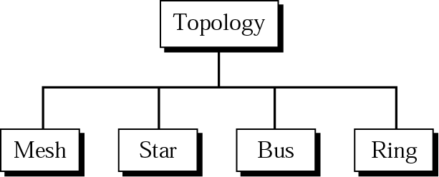
Categories of topology
The physical layout of network

Slide 9
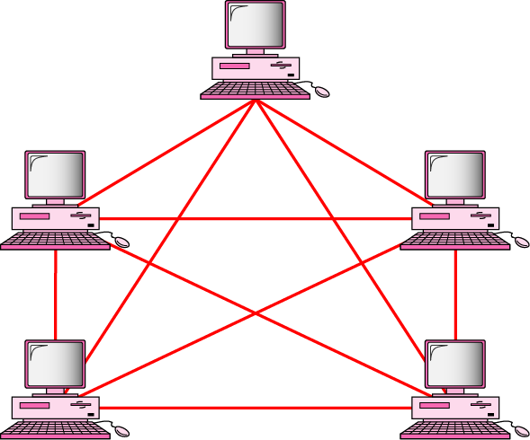
Fully connected mesh topology (for five devices)

Slide 10
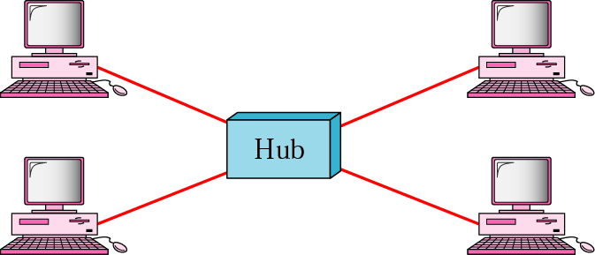
Star topology
The central device can be a HUB or a SWITCH

Slide 11
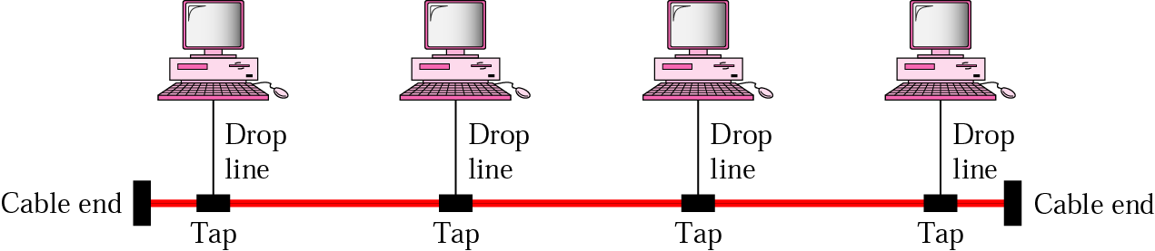
Bus topology
T-Connector for connecting nodes
and Terminator at the End

Slide 12
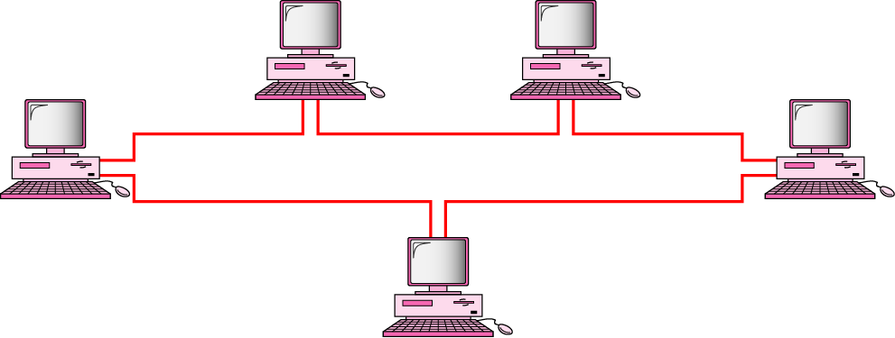
Ring topology
Can be circular too
Uses Token Ring

Slide 13
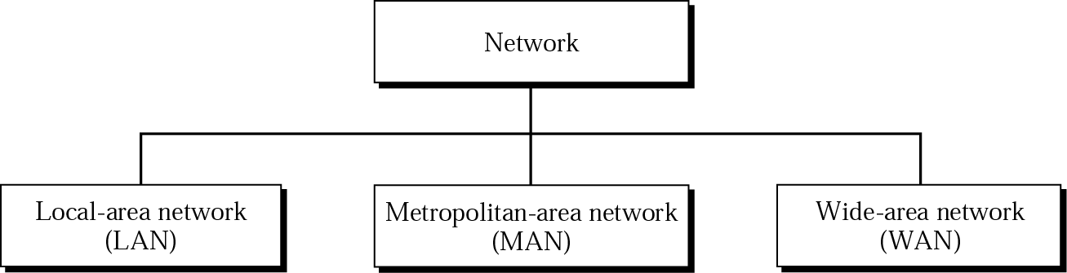
Categories of networks

Slide 14
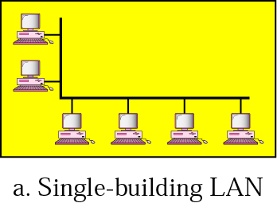
LAN
A local area network is a network system in which computers are interconnected in a limited geographical area, such as network of computers in college computer laboratory or network of computers in office building etc.

Slide 15
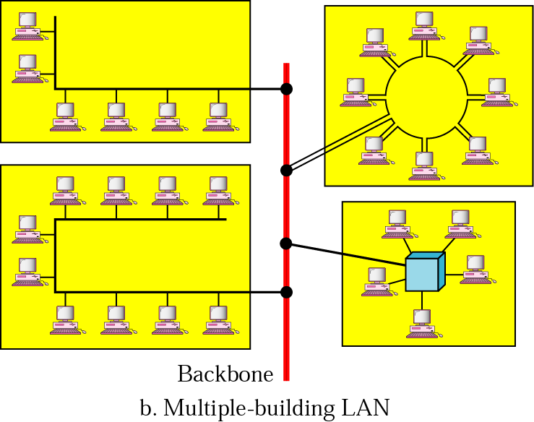
LAN (Continued)

Slide 16
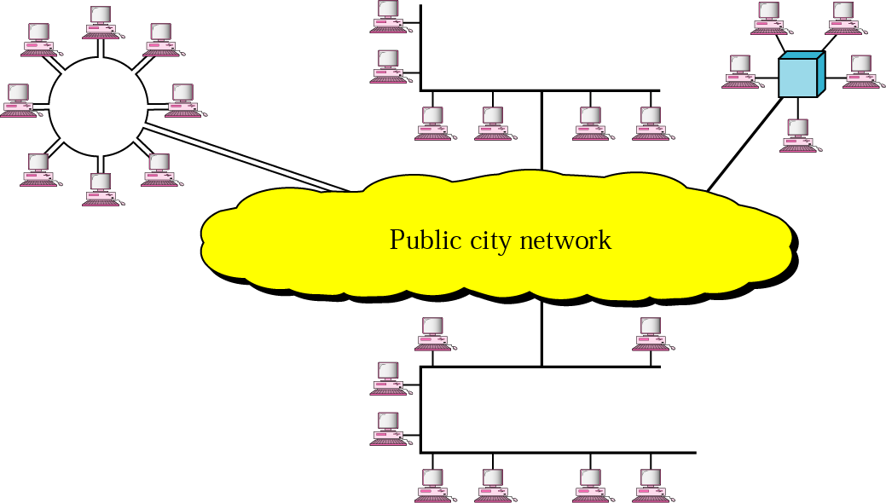
MAN
A Metropolitan area Network is a network system that covers area of a single city. Usually, MAN connects more than one LANS in a city or town and covers a smaller geographical area than a WAN. The cable television, telephone companies or local corporations use MAN.

Slide 17
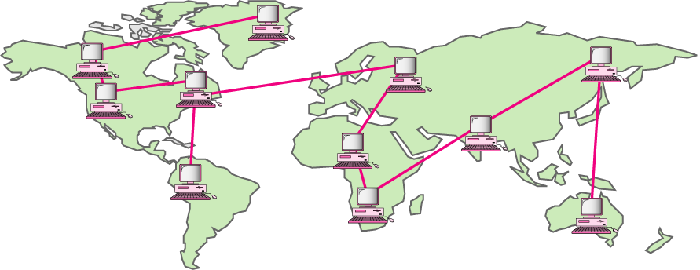
WAN
A wide area network is a network system that covers a large geographical area such as different cities of country or different countries of the world. In WAN telephone lines, satellites, microwave, fiber optic etc. are used as transmission media.

Slide 18
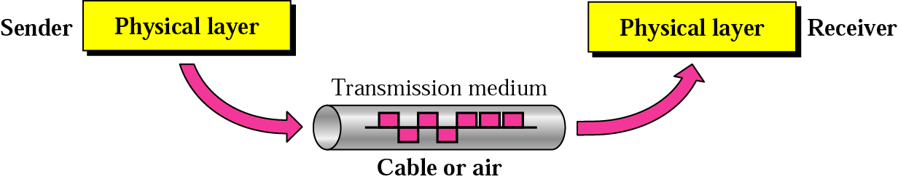
Transmission medium and physical layer

Slide 19
Physical Hardware Device
Concentrators, hubs, and repeaters, which regenerate electrical signals
Transmission media connectors, which provide the mechanical interface to interconnect devices to the transmission media
Modems and CODECs, which perform digital and analog conversions

Slide 20
Transmission
Media

Slide 21
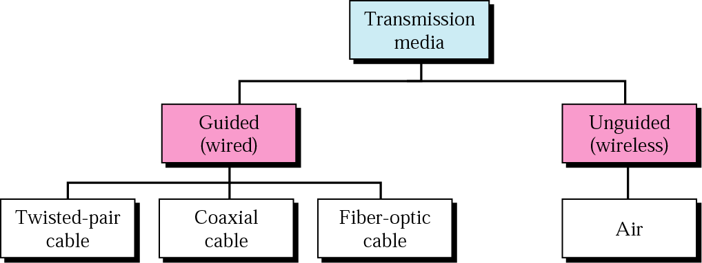
Classes of transmission media

Slide 22
Guided Media
Twisted-Pair Cable
Coaxial Cable
Fiber-Optic Cable

Slide 23
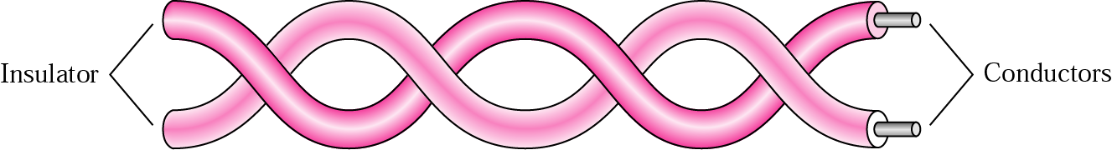
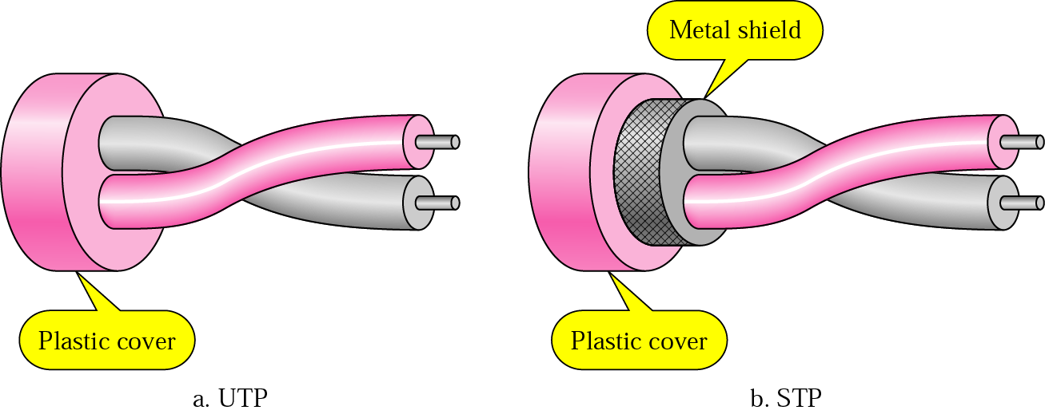
Twisted-pair cable

Slide 24
Table 1 Categories of unshielded twisted-pair cables
Category | Bandwidth | Data Rate | Digital/Analog | Use
1 | very low | < 100 kbps | Analog | Telephone
2 | < 2 MHz | 2 Mbps | Analog/digital | T-1 lines
3 | 16 MHz | 10 Mbps | Digital | LANs
4 | 20 MHz | 20 Mbps | Digital | LANs
5 | 100 MHz | 100 Mbps | Digital | LANs
6 (draft) | 200 MHz | 200 Mbps | Digital | LANs
7 (draft) | 600 MHz | 600 Mbps | Digital | LANs

Slide 25
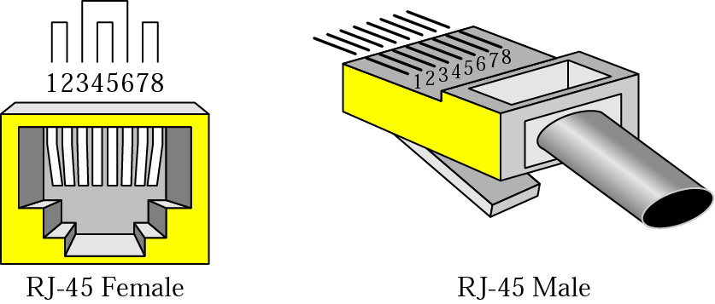
UTP connector

Slide 26
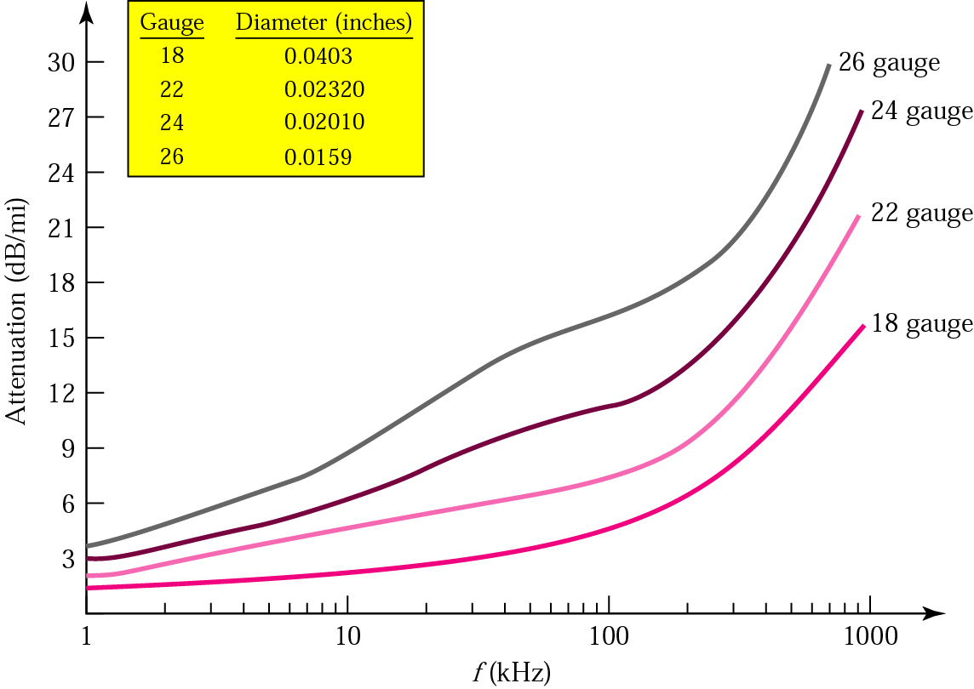
UTP performance

Slide 27
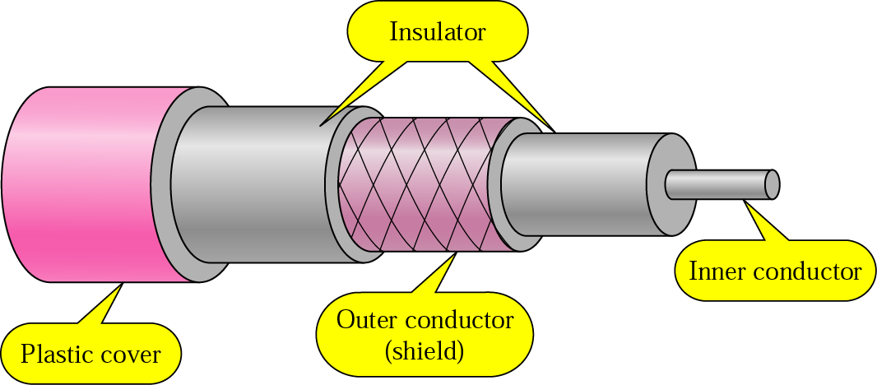
Coaxial cable

Slide 28
Categories of coaxial cables
Category | Impedance | Use
RG-59 | 75 Ω | Cable TV
RG-58 | 50 Ω | Thin Ethernet
RG-11 | 50 Ω | Thick Ethernet
Impedance: Resistance with zero phase angle. It describes a measure of opposition to
alternating current (AC)
10BASE5 (also known as thick ethernet or thicknet) is the original "full spec" variant of
Ethernet cable, using cable similar to RG-8/U coaxial cable but with extra braided shielding
10BASE2 (also known as cheapernet, thin Ethernet, thinnet, and thinwire) is a variant of
Ethernet that uses thin coaxial cable (RG-58A/U) terminated with BNC connectors.
The name 10BASE5 is derived from several characteristics of the physical medium.
The 10 refers to its transmission speed of 10 Mbit/s. The BASE is short for baseband signalling
as opposed to broadband, and the 5 stands for the maximum segment length of 500 metres.

Slide 29
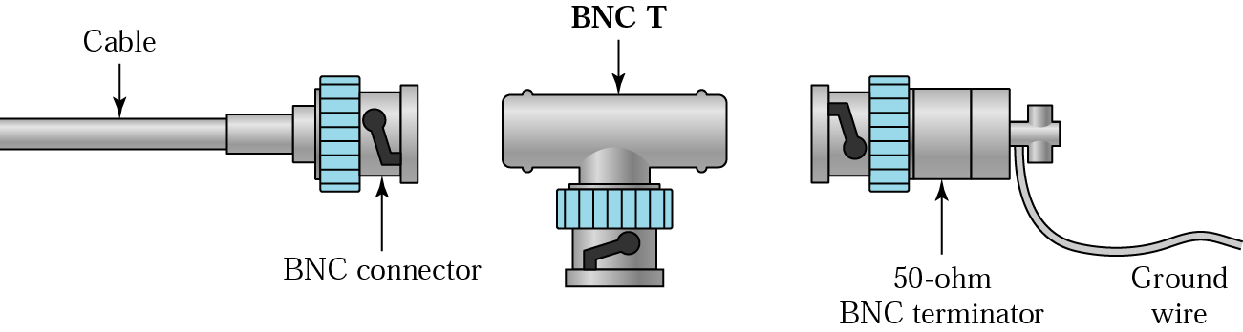
BNC connectors
Bayonet Neill-Councilman Connector

Slide 30
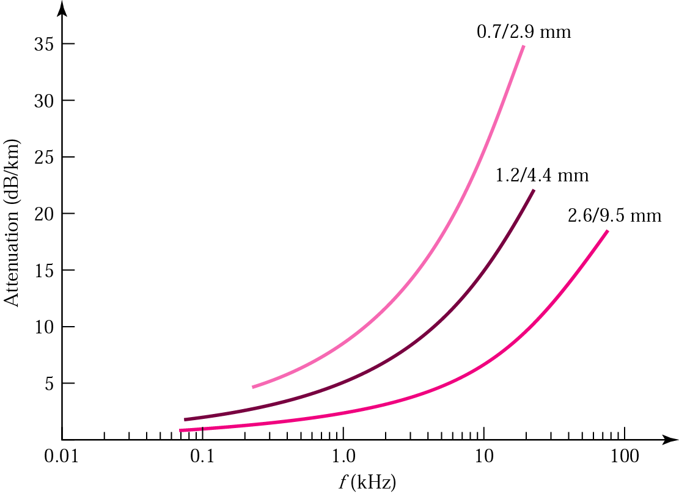
Coaxial cable performance
Attenuation: Affects the propagation of waves and signals in electrical circuits.
The gradual loss in intensity of any kind of flux through a medium

Slide 31
Optical Fiber

Slide 32
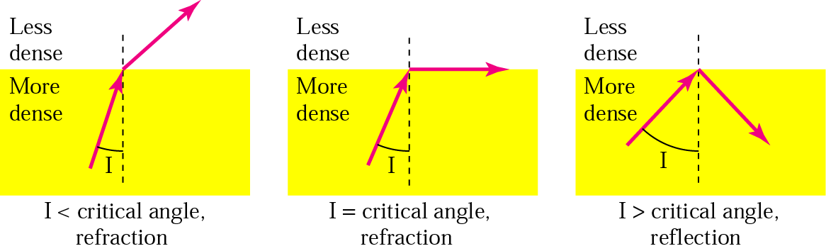
Figure 7.10 Bending of light ray
Critical Angle: At a refractive boundary, the smallest angle of incidence at which total internal reflection occurs.
A ray that exceeds a certain "critical" angle escapes from the fiber (yellow line).
Angle of Incidence: The angle between an incident ray and the normal to a
reflecting or refracting surface

Slide 33

Optical fiber
Cladding is the covering of one material with another. It has different meanings
depending on the context

Slide 34
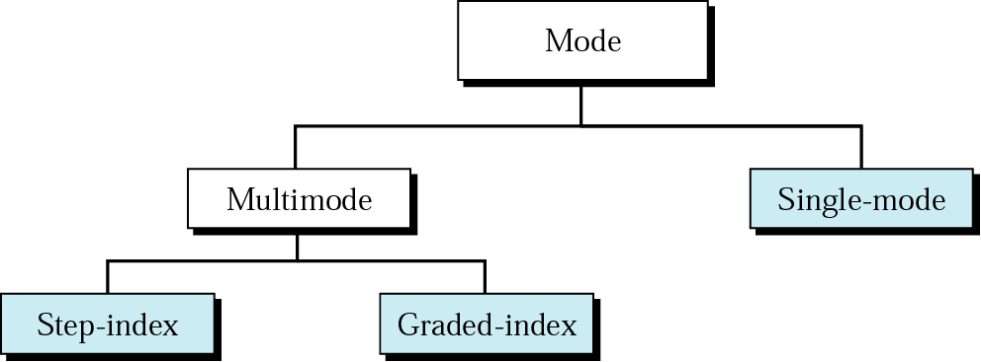
Propagation modes

Slide 35
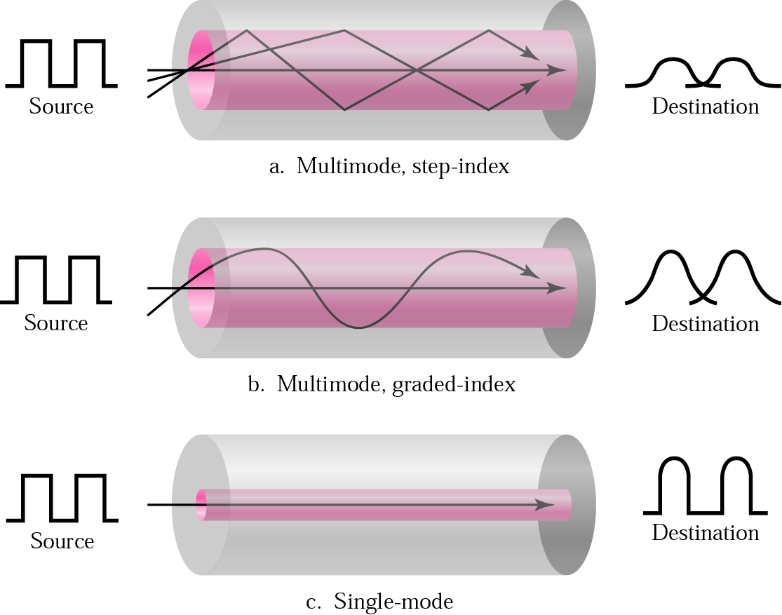
Modes
A step-index profile is a refractive index profile characterized by a uniform refractive index within the core

Slide 36
Table 3 Fiber types
Type | Core | Cladding | Mode
50/125 | 50 | 125 | Multimode, graded-index
62.5/125 | 62.5 | 125 | Multimode, graded-index
100/125 | 100 | 125 | Multimode, graded-index
7/125 | 7 | 125 | Single-mode

Slide 37
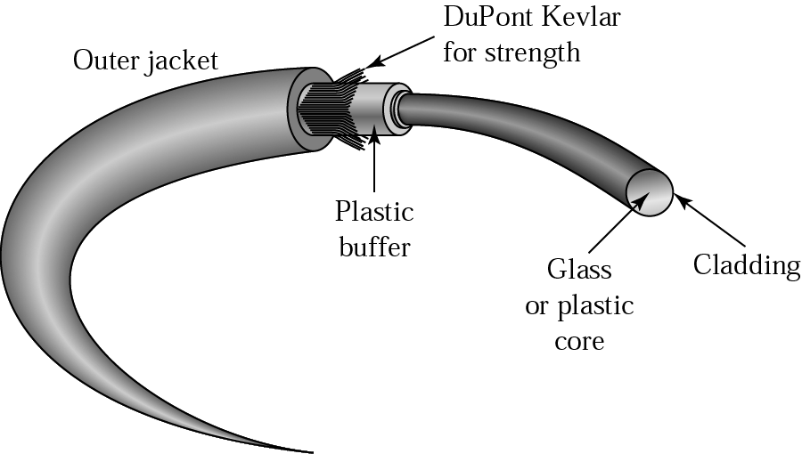
Fiber construction

Slide 38
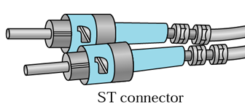
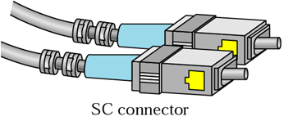
Fiber-optic cable connectors
ST: ST connector is used extensively both in the field and indoor fiber optic LAN applications. Its high-precision, ceramic ferrule allows its use with both multimode and single-mode fibers. The insertion loss of the ST connector is less than 0.5 dB, with typical values of 0.3 dB being routinely achieved.
SC: SC connector is becoming increasingly popular in single-mode fiber optic telecom and analog CATV, field deployed links. The high precision, ceramic ferrule construction is optimal for aligning single-mode optical fibers. The typical insertion loss of the SC connector is around 0.3 dB.

Slide 39
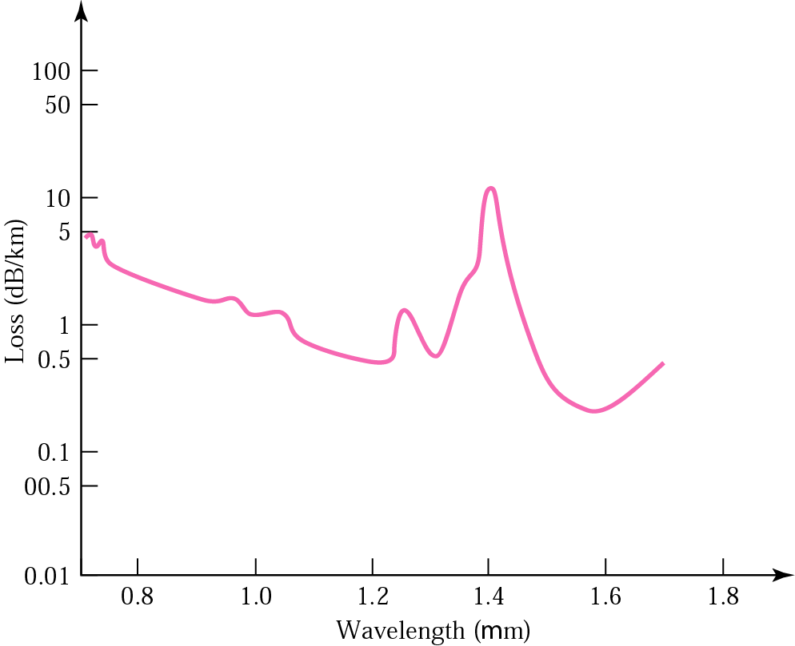
Optical fiber performance
Decibel is a logarithmic unit of measurement
in acoustics and electronics

Slide 40
Unguided Media: Wireless
Radio Waves
Microwaves
Infrared

Slide 41
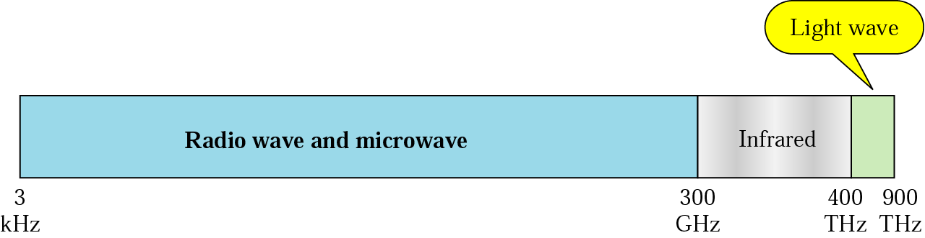
Electromagnetic spectrum for wireless communication

Slide 42
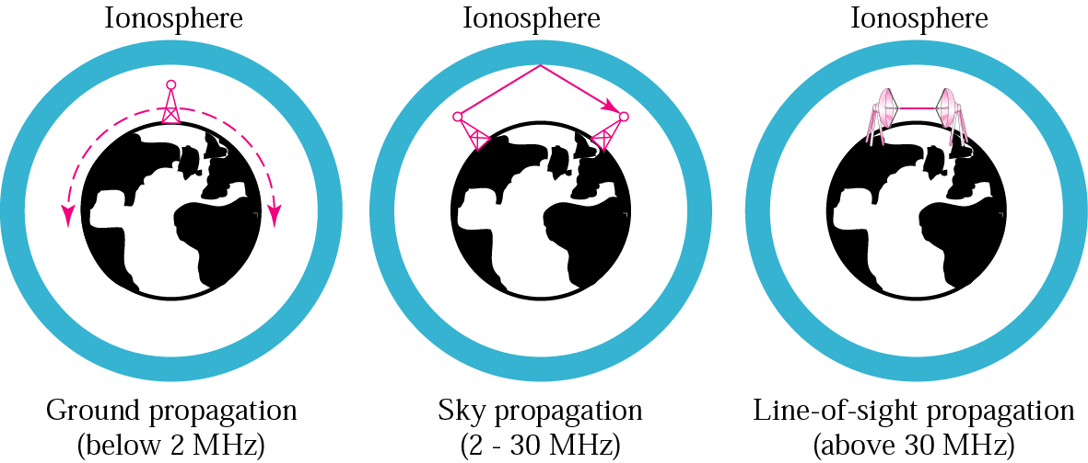
Propagation methods

Slide 43
Table 4 Bands
Band | Range | Propagation | Application
VLF | 3–30 KHz | Ground | Long-range radio navigation
LF | 30–300 KHz | Ground | Radio beacons and navigational locators
MF | 300 KHz–3 MHz | Sky | AM radio
HF | 3–30 MHz | Sky | Citizens band (CB), ship/aircraft communication
VHF | 30–300 MHz | Sky and line-of-sight | VHF TV, FM radio
UHF | 300 MHz–3 GHz | Line-of-sight | UHF TV, cellular phones, paging, satellite
SHF | 3–30 GHz | Line-of-sight | Satellite communication
EHF | 30–300 GHz | Line-of-sight | Long-range radio navigation
Propagation: The ways in which waves travel

Slide 44
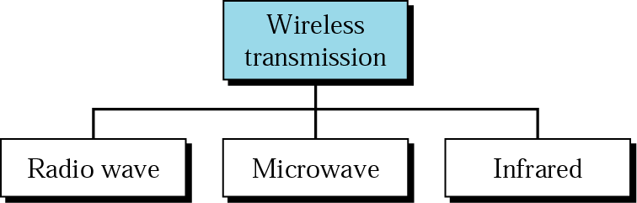
Wireless transmission waves

Slide 45
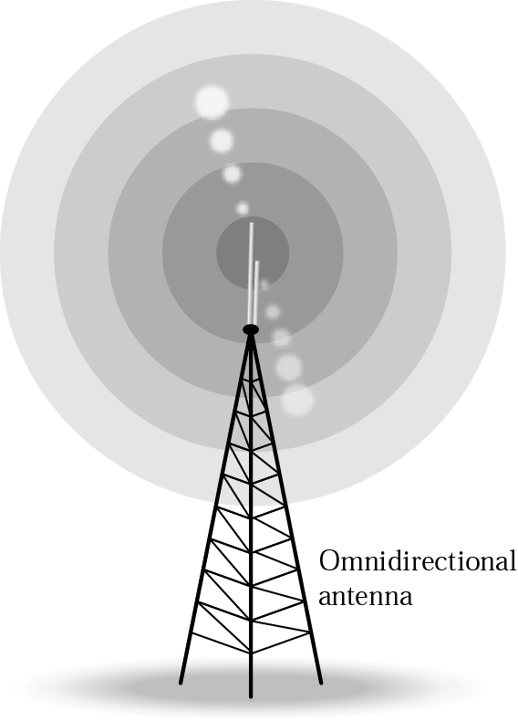
Omni-directional antennas

Slide 46

Note:
Radio waves are used for multicast communications, such as radio and television, and paging systems.

Slide 47
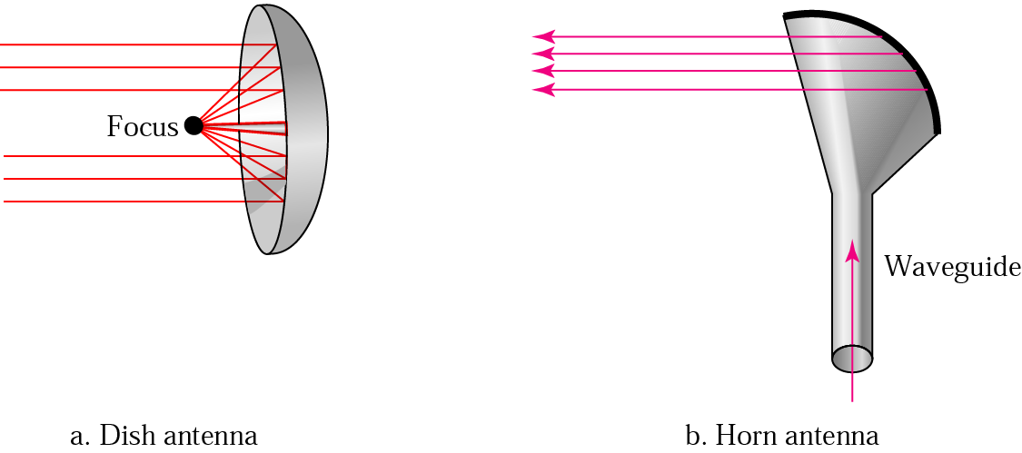
Unidirectional antennas

Slide 48
Note:
Microwaves are used for unicast communication such as cellular telephones, satellite networks, and wireless LANs.

Slide 49
Note:
Infrared signals can be used for short-range communication in a closed area using line-of-sight propagation.

Slide 50
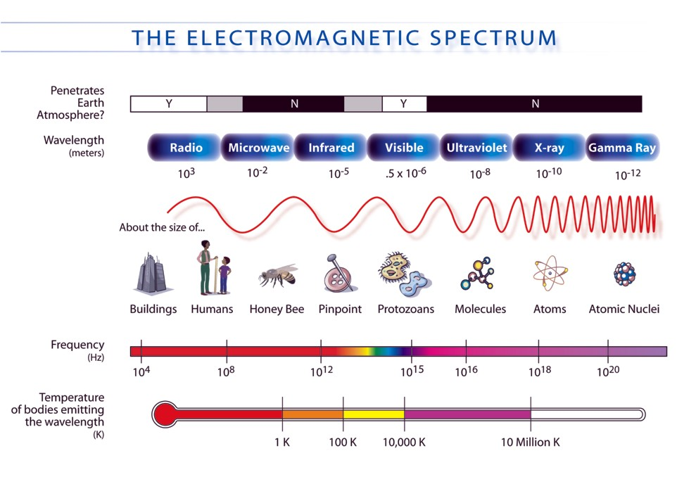

Slide 51
Cable Creation

Slide 52
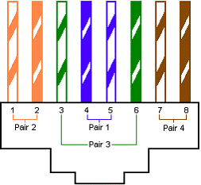
Straight through

Slide 53
Crossover-A

Slide 54
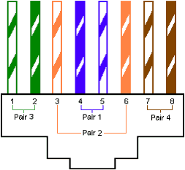
Crossover-B

